Slide 1

Small Scale Collaborative Study for the
Determination of Trifluralin TC and EC formulation by HPLC
Report to CIPAC
by
Shenyang SYRICI Testing Co., Ltd.
Method developed by Jiangsu Fengshan

Slide 2
Content
PARTICIPANTS
AI GENERAL INFORMATION
SAMPLES
METHOD
REMARKS OF THE PARTICIPANTS
EVALUATION AND DISCUSSION
CONCLUSIONS

Slide 3
Participants
Small Scale Collaborative Study for the determination of trifluralin TC and EC formulation by HPLC was organized by Shenyang SYRICI Testing Co., Ltd, and participated by 4 labs. All of the 4 laboratories provided their results.

Slide 4
Participants

Slide 5

AI General Information
Trifluralin
Chemical name: 2,6-dinitro-N,N-dipropyl-4-(trifluoromethyl) benzenamine)
CAS-No.: 1582-09-8
Molecular mass: 335.3 g/mol
Empirical formula: C₁₃H₁₆F₃N₃O₄

Slide 6
Samples
Trifluralin tech. (TC-1 Batch No. 2020071501)
Trifluralin tech. (TC-2 Batch No. 2020081903)
Trifluralin EC (EC-1 Batch No. 2020062401)
Trifluralin EC (EC-2 Batch No. 2020072401)
Trifluralin EC (EC-3 Batch No. 2020080701)
Trifluralin, reference standard (purity 99.3 %w/w)

Slide 7
Method
4.1 Scope
The determination of Trifluralin content in TC and EC formulation.
4.2 Principle
Trifluralin is determined by reversed HPLC
using UV detection at 280 nm and external standardization.

Slide 8
Method Condition
Column: Eclipse Zorbax XDB-C8 150 x 4.6 mm (i.d.), 5 um
Mobile phase: Acetonitrile: water=77:23(V/V)
Column temperature: 25℃
Injection volume: 5ul
Flow rate: 1.0ml/min
Detector wavelength: 280nm
Run time: 8.00 min
Retention time: approximately 5.2 min

Slide 9
Method
4.3 Procedure
Each sample was analyzed using four independent determinations. The samples were analyzed on two different days, each day involving duplicate injections of duplicate weights. Both test and reference solutions were freshly prepared on each day. The four injections of each test solution were bracketed by double injections of the calibration solution. The average Trifluralin in the test solution, was calculated using the injection before and after the test injections.

Slide 10
Analytical Condition of Participants

Slide 11
6.1 Data Review
In summary it can be stated that the method deviations, noted by the participants, were deemed not to affect the analytical results significantly and therefore all data sets from 4 participating laboratories were included within the statistical assessment.

Slide 12
6.2 Determination of Trifluralin
The statistical evaluation of the data was accomplished following the “Guidelines for CIPAC Collaborative Study Procedures for Assessment of Performance of Analytical Methods”, according to DIN ISO 5725. The testing for outliers/stragglers of the laboratory mean values were performed according to Grubbs test on a 1%/5% significance level, respectively.

Slide 13
Table 1 Results of 4 labs

Slide 14
Table 2 Mean values

Slide 15
Table 3 Summary of the statistical evaluation

Slide 16
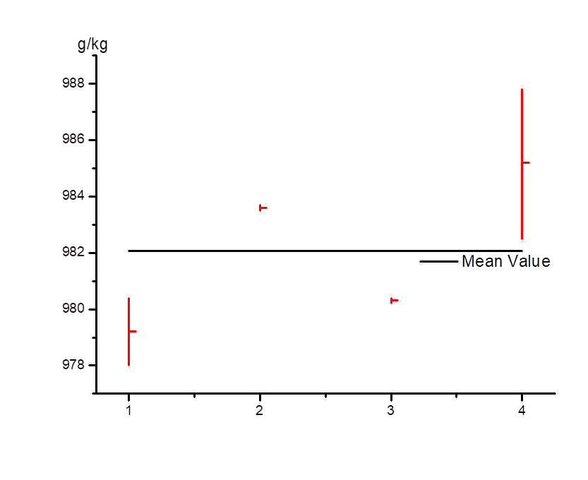
Fig. 1 Trifluralin TC-1
Mean value: 982.06 g/kg
Sr: 3.09
SR: 3.88
RSDR: 0.40
RSDR（Hor）: 1.42
HorRat: 0.279
Outlier (Grubbs): none
Straggler (Grubbs)： none

Slide 17
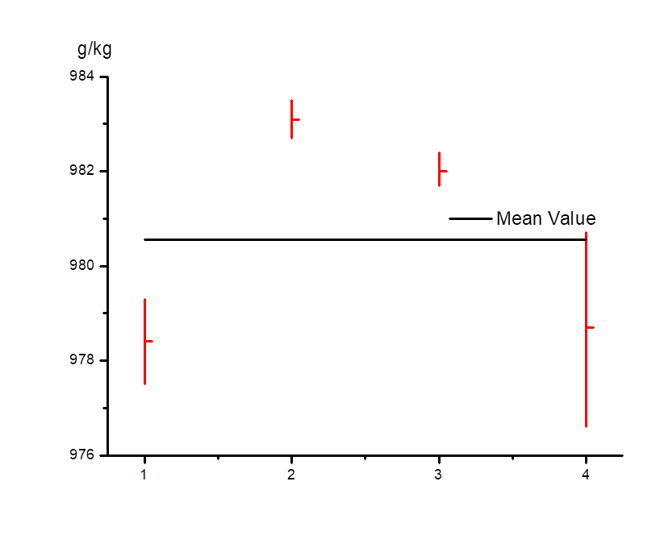
Fig. 2 Trifluralin TC-2
Mean value: 980.55 g/kg
Sr: 2.32
SR: 3.12
RSDR: 0.32
RSDR（Hor）: 1.42
HorRat: 0.224
Outlier (Grubbs): none
Straggler (Grubbs)： none

Slide 18
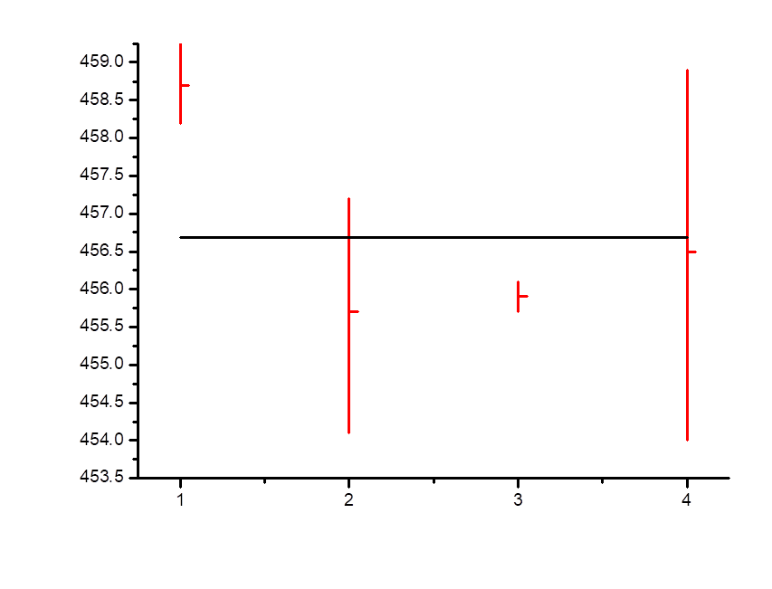
Fig. Trifluralin EC-1
Mean value: 456.68 g/kg
S_{r}: 2.00
S_{R}: 2.23
RSD_{R}: 0.49
RSD_{R（Hor）:} 1.59
HorRat: 0.307
Outlier (Grubbs)： none
Straggler (Grubbs)： none

Slide 19
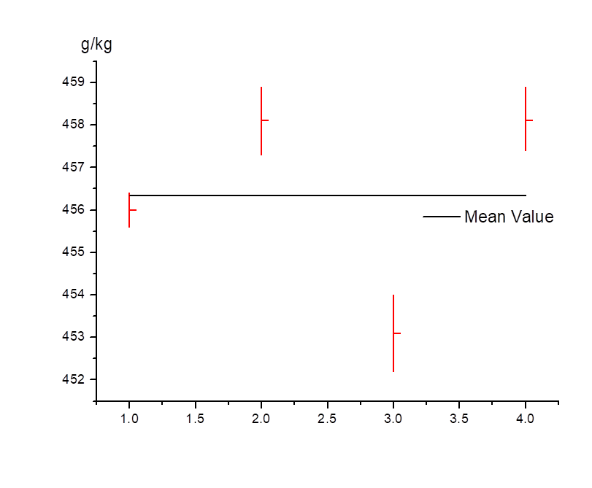
Fig. 4 Trifluralin EC– 2
Mean value: 456.33 g/kg
S_{r}: 2.04
S_{R}: 2.96
RSD_{R}: 0.65
RSD_{R（Hor）:} 1.59
HorRat: 0.408
Outlier (Grubbs): none
Straggler (Grubbs): none

Slide 20
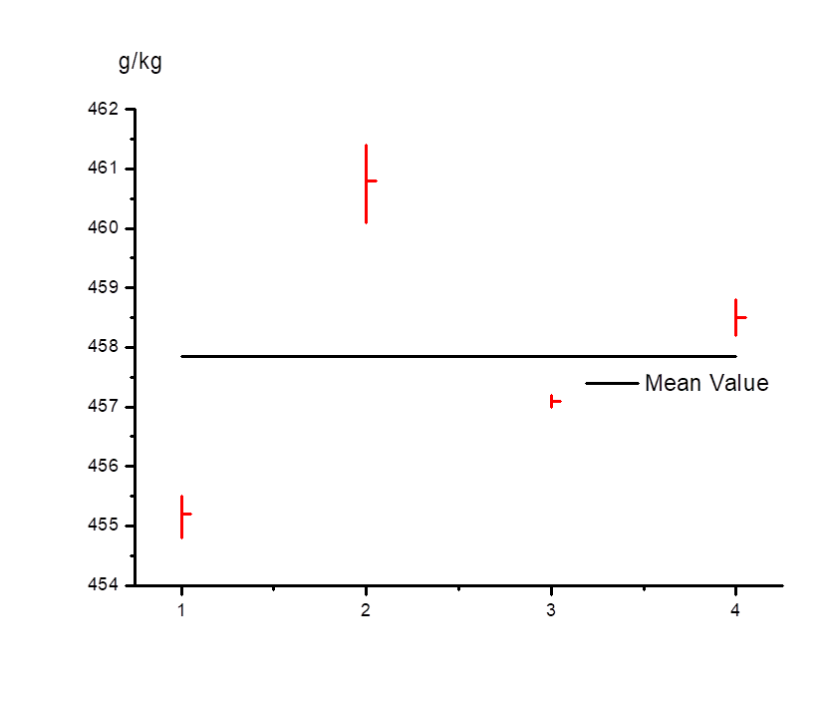
Fig. 4 Trifluralin EC– 3
Mean value: 457.85 g/kg
Sr: 1.58
SR: 2.74
RSDR: 0.6
RSDR（Hor）: 1.59
HorRat: 0.376
Outlier (Grubbs): none
Straggler (Grubbs): none

Slide 21
7. Conclusions
A total of 4 different laboratories have participated in this small scale collaborative study.
The data presented in the statistical summary show that this method led to HorRat values all within the required range. That is evidence for the fact that the present LC method is acceptable and suitable to produce reproducible results.
SYRICIT considers this method to be suitable for the intended purpose, without further changes, and recommends for performing large-scale collaborative trials.

Slide 22
Thank You
Any Question?
songjunhua@sinochem.com

